Slide 1
Future of Blockchain
Paras Dalal
May 17, 2022

Slide 2
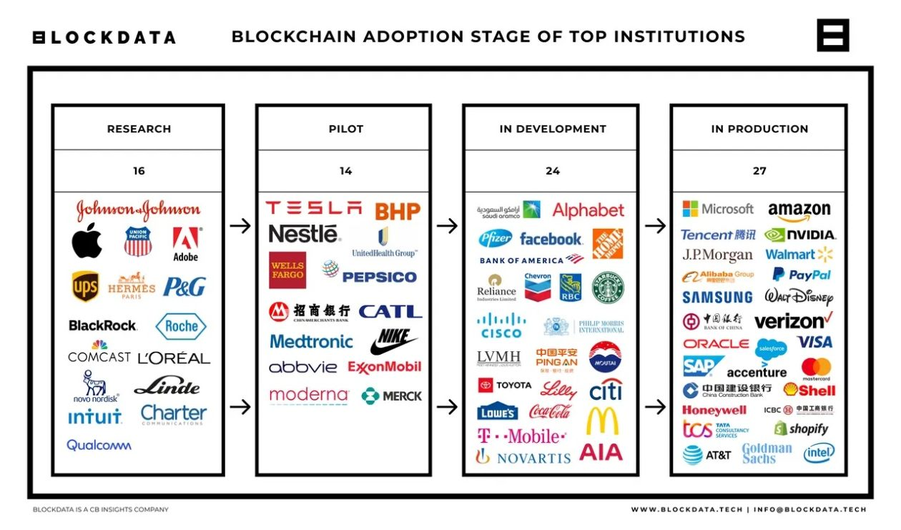
Who ?
https://forkast.news/81-of-top-100-companies-use-blockchain-technology-blockdata/
Notes:
In 2014 only 2 companies were using Blockchain – Paypal & Walt Disney
By year 2021, 81 out of top 100 US companies (by market capitalization) are using it

Slide 3
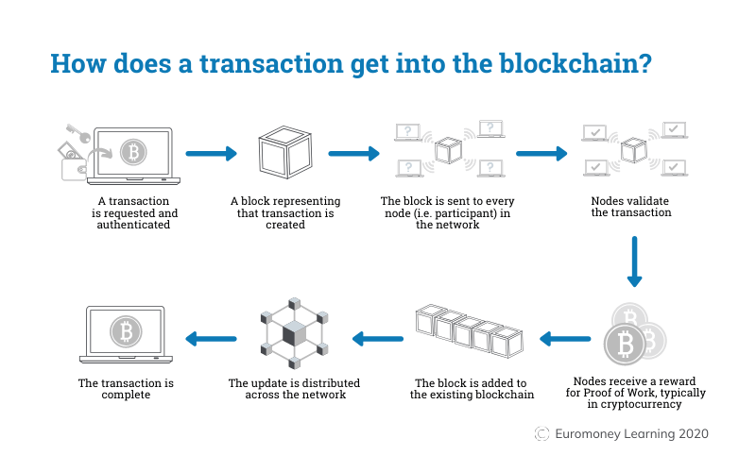
What/How?
https://demoblockchain.org/blockchain https://ocw.mit.edu/courses/15-s12-blockchain-and-money-fall-2018/
https://www.euromoney.com/learning/blockchain-explained/how-transactions-get-into-the-blockchain
Notes:
Chain of blocks
Distributed network
Proof of work – Difficult to create, easy to check

Slide 4
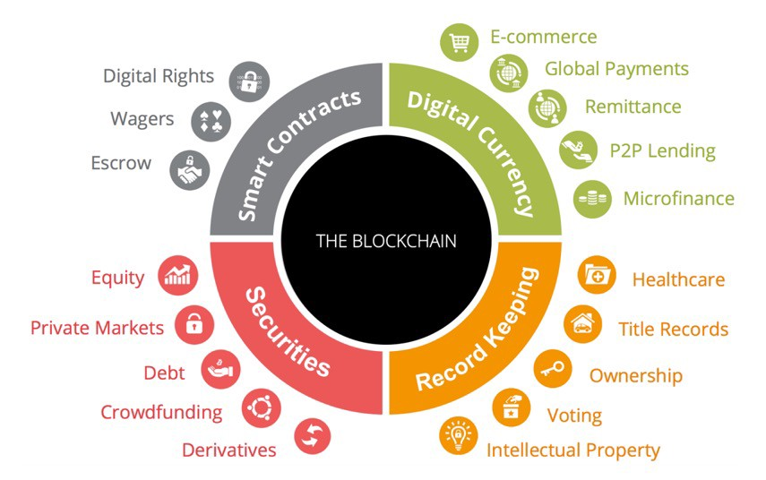
Where/Why ?
https://medium.com/practical-blockchain/use-cases-of-blockchain-tech-application-13a940edf6fb
Notes:
Sectors – Finance, Healthcare, Real estate, Politics
Digital currency – Strong security, immutability
Record keeping – Immutability, Large distributed network
Real estate title insurance via decentralized title registry
Securities – Storage of value
Smart contracts – Instant transaction, All parties on the same page, Bound by digital signatures Copyrighted music distribution (avoid piracy – smart contract – Front loaded, written in code

Slide 5
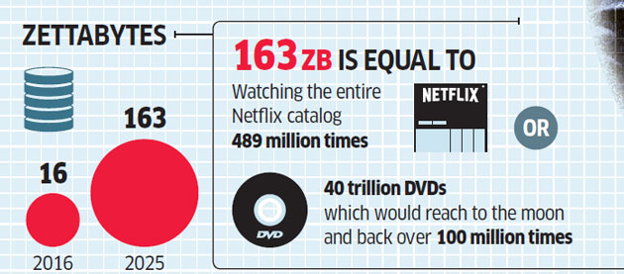
Use Case: Large Data
Data Overflow
1,000,000,000,000,000,000,000 (10²¹ = 1 Billion Terabytes)
Filecoin (filecoin.io) is a blockchain-based system allowing users to rent unused hard drive space
https://economictimes.indiatimes.com/tech/internet/total-worldwide-data-will-swell-to-163-zettabytes-by-2025/articleshow/58118131.cms
Notes:
Example is FileCoin (Sia.tech)

Slide 6
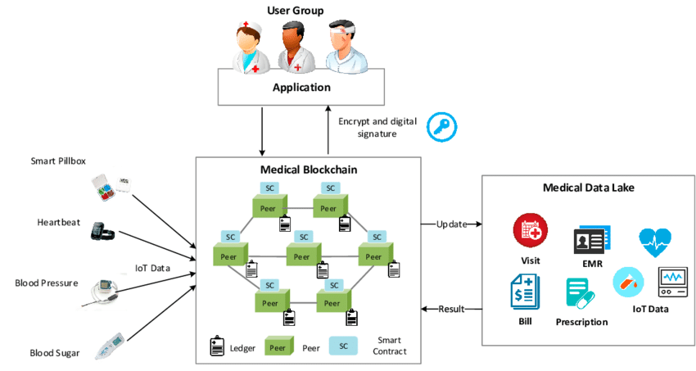
Use Case: Medical Records
https://www.researchgate.net/figure/Conceptual-scenario-of-medical-blockchain_fig1_332652213
Notes:
Use case – Change of doctor, need while on vacation

Slide 7
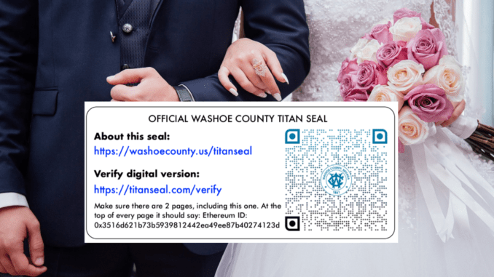
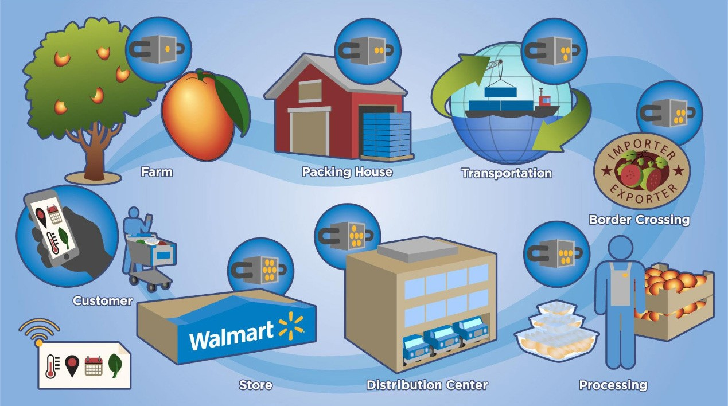
Other Use Cases
7
For internal use only
Notes:
Marriage licenses via smart contract (Reno – State of Nevada)
Supply chain with transparency of origin (Walmart) – started in 2016. Origin information from 6 days to 3 seconds

Slide 8
Possible Use Cases for Bessemer
May need to participate in various public blockchains
E.g. Zero day settlement using smart contracts
Crypto positions and digital assets of our clients
May need to have private blockchain to reflect in our books
Speed of getting data to client
Private blockchain at our regional offices with historical data
Notes:
Focused on Investment Management

Slide 9
Future?
Lower cost of transaction
Scalability
Security
Governance
Notes:
Cost - Proof of work requires vast amount of computing power and electricity
Scalability - Large blockchain makes the speed of transactions slow (7 bitcoin tran vs 1700 visa/5000 mastercard per second)
Security – Private key is the strength and the weakness/use of biomatrics
Governance - Lack of governance due to early stage of technology, Governing bodies, smarter algorithms
Metaverse – As rich as real world – avatars (kid/sage)
Crypto, NFTs, IoT processing, Virtual reality

Slide 10


Slide 11
For internal use only

